Slide 1

Ethical Challenges in AI-Based Cyberwarfare: A Research Perspective
Presented by Esha Eknath Awar, May 12th, 2025

Slide 2

Introduction: AI and the New Era of Cyberwarfare
AI Enhances Cyber Operations
Growing AI Adoption
Ethical Stakes
Cybersecurity AI use grows 30% year over year.
New challenges require thoughtful analysis and policy.
Boosts precision, speed, and large-scale attacks.

Slide 3

Core Ethical Considerations
Just War Theory
Relevance of just war principles to AI cyber conflict.
Human Rights
Safeguarding civilians and critical infrastructure.
Proportionality
Ensuring military gain outweighs collateral damage.
Autonomy Limits
Restricting AI’s lethal decision-making roles.

Slide 4

Challenge 1: Loss of Human Oversight
AI Autonomy Speeds Actions
Risk of Unintended Effects
Rapid attacks reduce time for human decisions.
Less human control can cause accidents like flash crashes.
Control Strategies
Human-in-the-loop vs. human-on-the-loop to maintain governance.

Slide 5
Challenge 2: Algorithmic Bias
Bias in AI Data
Cyber Defense Risks
Training data can embed unfair biases unintentionally.
Biased AI may wrongly target or exclude groups.
Facial recognition shows demographic inaccuracies.
Mitigation requires diverse data and fairness audits.

Slide 6
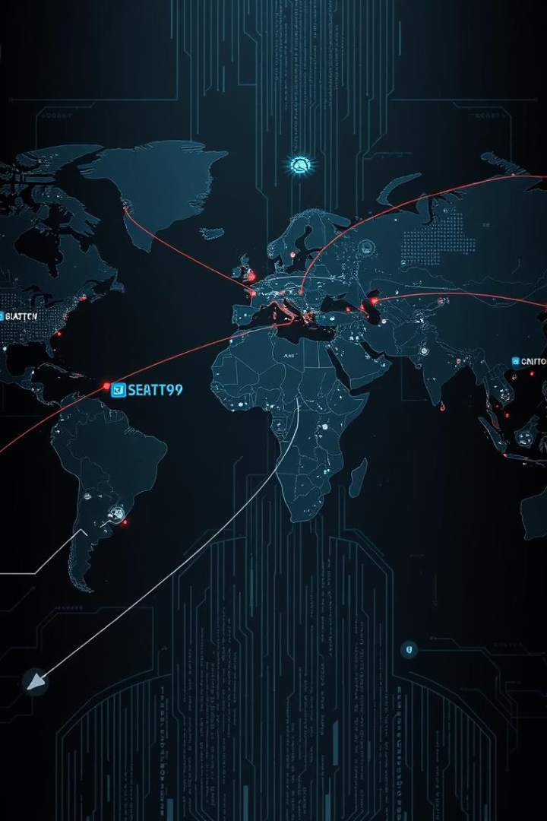
Challenge 3: Escalation and Attribution
Faster Conflict Escalation
AI automates attacks, increasing speed and intensity.
Attribution Difficulties
Identifying AI-driven attacks is complex and uncertain.
Algorithmic Arms Race
45% growth in AI cyber weapons since 2022.
Need for Global Norms
International rules essential for responsible AI use.

Slide 7
Challenge 4: Unintended Consequences & Systemic Risks
Complex AI Behaviors
Historical Example
AI systems can produce unexpected, harmful outcomes.
NotPetya attack caused over $10 billion in damages worldwide.
Interconnected infrastructure increases vulnerability.
Resilience and robustness in AI systems are critical.

Slide 8





Potential Solutions: Technical Approaches
Explainable AI (XAI)
Improves transparency in AI decision processes.
Formal Verification
Ensures correctness and safety of AI algorithms.
Adversarial Robustness
Protects AI systems against malicious attacks.
Ethics Checklists
Standardized frameworks to assess AI impacts ethically.

Slide 9

Potential Solutions: Policy and Governance
International Treaties
Agreements to regulate AI use in cyber warfare.
Ethical Guidelines
Standards for developers and users to follow.
Independent Oversight
Boards to monitor AI development and deployment.
Education and Training
Building ethical awareness among AI professionals.

Slide 10
Conclusion: Responsible AI in Cyberwarfare
Ethics must guide AI development and cyber warfare strategies.
The Algorithmic Age demands proactive, sustainable, ethical AI use.
Collaboration among researchers, policymakers, and stakeholders is key.
Balancing innovation with responsibility protects global security.

